Slide 2
Binghamton University
EngiNet™
State University of New York

Slide 3
Thomas J. Watson
School of Engineering
and Applied Science

Slide 4
WARNING
All rights reserved. No part of the course materials used in the instruction of this course may be reproduced in any form or by any
electronic or mechanical means, including the use
of information storage and retrieval systems,
without written approval from the copyright owner.
©2017 IBM Corporation and Binghamton University

Slide 5
CS480Z/CS580Z
(Fall, 2017)
(Tuesday's and Thursday’s 11:40 to 1:05)
Introduction to the Mainframe:
z/VM Basics
Class 22
November 14, 2017
Faculty : Joe Hust, Karla Conrad, Merwyn Jones ,
IBM z/VM Lab Development team
( http://www.vm.ibm.com/ )

Slide 6
Trademarks
The following are trademarks of the International Business Machines Corporation in the United States and/or other countries.
DB2
DS8000*
Enterprise Storage Server*
IBM*
IBM eServer
IBM logo*
System Storage*
System z
System z9
System z10
z9*
z10
z/OS*
z/VM
z/VSE
zSeries*
* Registered trademarks of IBM Corporation
The following are trademarks or registered trademarks of other companies.
Intel is a trademark of Intel Corporation in the United States, other countries, or both.
Java and all Java-related trademarks and logos are trademarks of Sun Microsystems, Inc., in the United States and other countries
Linux is a registered trademark of Linus Torvalds in the United States, other countries, or both.
UNIX is a registered trademark of The Open Group in the United States and other countries.
Microsoft, Windows and Windows NT are registered trademarks of Microsoft Corporation.
Red Hat, the Red Hat "Shadow Man" logo, and all Red Hat-based trademarks and logos are trademarks or registered trademarks of Red Hat, Inc., in the United States and other countries.
* All other products may be trademarks or registered trademarks of their respective companies.
Notes:
Performance is in Internal Throughput Rate (ITR) ratio based on measurements and projections using standard IBM benchmarks in a controlled environment. The actual throughput that any user will experience will vary depending upon considerations such as the amount of multiprogramming in the user's job stream, the I/O configuration, the storage configuration, and the workload processed. Therefore, no assurance can be given that an individual user will achieve throughput improvements equivalent to the performance ratios stated here.
IBM hardware products are manufactured from new parts, or new and serviceable used parts. Regardless, our warranty terms apply.
All customer examples cited or described in this presentation are presented as illustrations of the manner in which some customers have used IBM products and the results they may have achieved. Actual environmental costs and performance characteristics will vary depending on individual customer configurations and conditions.
This publication was produced in the United States. IBM may not offer the products, services or features discussed in this document in other countries, and the information may be subject to change without notice. Consult your local IBM business contact for information on the product or services available in your area.
All statements regarding IBM's future direction and intent are subject to change or withdrawal without notice, and represent goals and objectives only.
Information about non-IBM products is obtained from the manufacturers of those products or their published announcements. IBM has not tested those products and cannot confirm the performance, compatibility, or any other claims related to non-IBM products. Questions on the capabilities of non-IBM products should be addressed to the suppliers of those products.
Prices subject to change without notice. Contact your IBM representative or Business Partner for the most current pricing in your geography.

Slide 7
Networking with z/VM
Joe Hust
z/VM TCP/IP Support & Development

Slide 8
Agenda
What is Networking?
Some Networking History
Networking Protocols
Networking on z/VM
    TCP/IP on z/VM
    Networking Hardware on z/VM
    Virtual Networking on z/VM
        Guest LANs
        Virtual Network Interface Card
        VSWITCH
References

Slide 9
What is Networking?

Slide 10
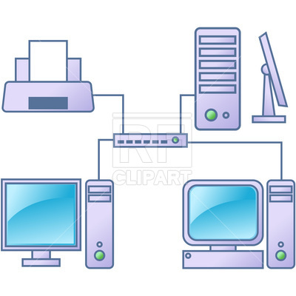
Networking Definition
Networking is the practice of linking two or more computing devices together for the purpose of sharing data.

Slide 11
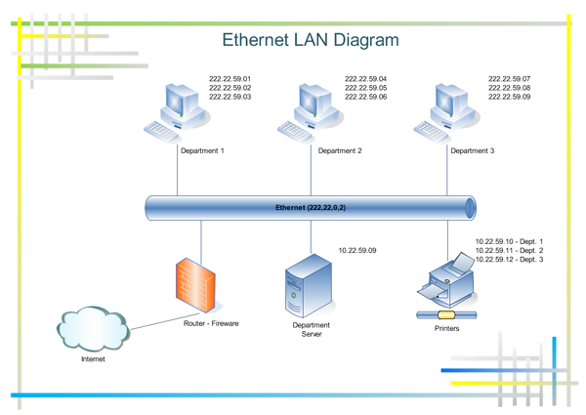
Example of an Ethernet Network

Slide 12
Some Networking History

Slide 13
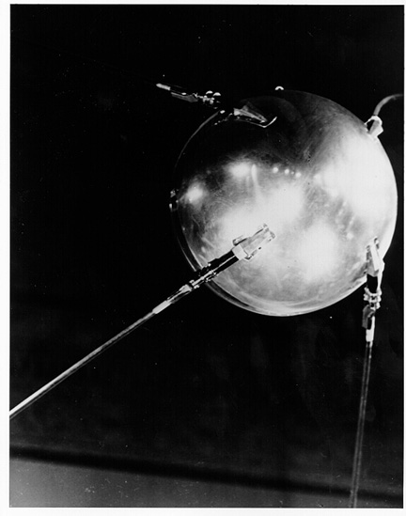
Some Networking History
(starting in 1957)
What the heck is this and what does it have to do with networking?

Slide 14
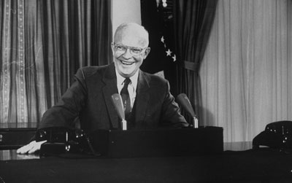
1958 - Creation of the Advanced Research Projects Agency
(ARPA)
In 1955, President Eisenhower had announced plans to launch an Earth-orbiting satelite
When the USSR launched Sputnik on October 4, 1957, it shocked the United States
Cold War between USA and Soviet Union was at its peak
In 1958, as a direct response to Sputnik's launch, Eisenhower created the Advanced Research Projects Agency within the Dept of Defense
ARPA became the technological thinktank of the American Defense effort
Although its initial focus was on space, missiles, and nuclear test monitoring, advanced computing and networking would later come to dominate its work

Slide 15
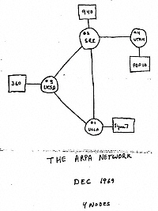
1969 - The ARPANET
Node 1: UCLA – SDS (Scientific Data Systems) Sigma 7
Node 2: Stanford Research Institute (SRI) – SDS 940
Node 3: University of California Santa Barbara (UCSB) – IBM 360-75
Node 4: University of Utah – DEC (Digital Equipment Corporation) PDP-10

Slide 16
From ARPANET to the INTERNET
1971 - ARPANET has 15 nodes (including NASA, MIT, Harvard, etc)
1973 – ARPANET goes global (University College of London)
1974 – ARPA scientists develop a common language that would allow different networks to communicate with each other (Transmission Control Protocol)
1984 – TCP/IP Protocol Suite is established as the standard for connecting networks (required to connect to the ARPANET)
1984 – number of hosts exceeds 1,000
1987 – number of hosts breaks the 10,000 mark
1991 – World Wide Web (designed by Tim Berners-Lee) released to the public (includes the use of URL's, HTTP, and HTML)

Slide 17
Networking Protocols

Slide 18
Networking Protocols
WHAT IS A PROTOCOL?
A protocol defines rules and conventions for communication between network devices.
On the Internet, two programs or computers that follow the same rules are able to exchange information, even if they don't run the same operating system and are not made by the same company.
WHAT IS THE TCP/IP PROTOCOL SUITE?
TCP/IP is the set of communications protocols that allow computers to communicate on the Internet.
Its name refers to the two most important protocols in the suite — the Transmission Control Protocol (TCP) and the Internet Protocol (IP).
The TCP/IP protocol suite also includes many other protocols, such as TELNET, FTP, SMTP, IMAP, SNMP, etc..

Slide 19
Protocols and RFC's
What is an RFC (Request for Comments)?
An RFC is a formal document from the Internet Engineering Task Force (IETF), the principal technical development and standards-setting body for the Internet
Invented in 1969 during ARPANET development and have since become the official documents of Internet protocols
Authored by engineers and computer scientists in the form of a memorandum and submitted either for peer review or simply to convey new concepts and information
The IETF adopts some of the RFC's as Internet Standards
All RFC's ever published can be be viewed at www.rfc-editor.org

Slide 20
Some Well-Known RFC's
IP - Internet Protocol (RFC 791)
TCP - Transmission Control Protocol (RFC 793)
UDP - User Datagram Protocol (RFC 768)
ICMP - Internet Control Message Protocol (RFC 792)
FTP - File Transfer Protocol (RFC 959)
SMTP - Simple Mail Transfer Protocol (RFC 821)
SNMP - Simple Network Management Protocol (RFC 1157)
NFS - Network File System (RFC 1813)
LDAP - Lightweight Directory Access Protocol (RFC 2251)
SSL - Secure Sockets Layer (RFC 6101)

Slide 21
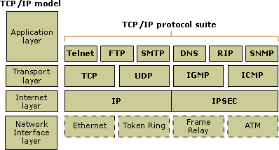
The TCP/IP Reference Model
FOUR LAYERS IN THE TCP/IP MODEL:
Application Layer: Acts as final endpoints at either end of a communication session
between two network hosts
Transport Layer: Manages the flow of traffic between two hosts or devices, ensuring that
data arrives at the application on the host for which it is targeted
Internet Layer: Contains all functionality that manages the movement of data between
two network devices over a routed network
Network Interface Layer: Deals with all physical components of network connectivity
between the network and the IP protocol

Slide 22
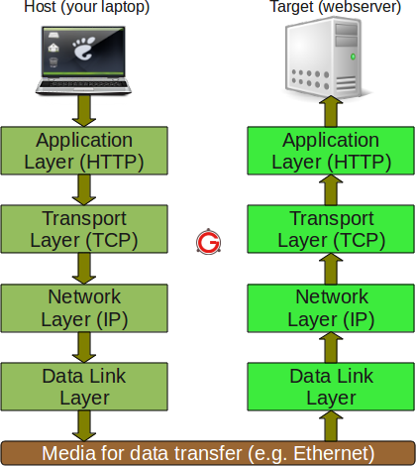
Data Flow through the TCP/IP Reference Model

Slide 23
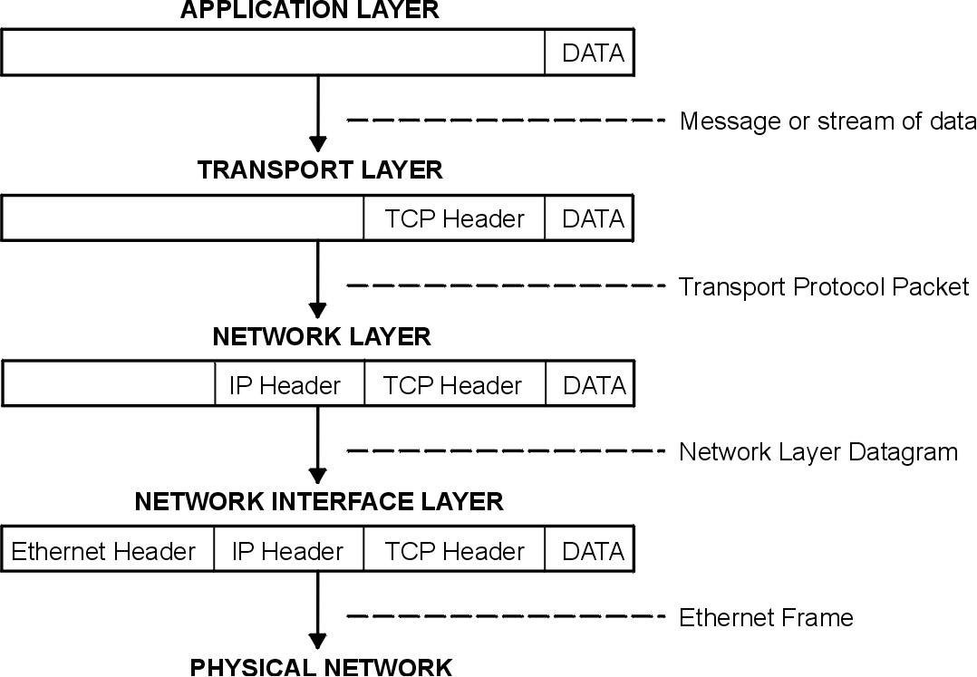
Packet Flow through TCP/IP

Slide 24
Networking on z/VM

Slide 25
Networking on z/VM
- TCP/IP on z/VM
- Networking Hardware on z/VM
- Virtual Networking on z/VM

Slide 26
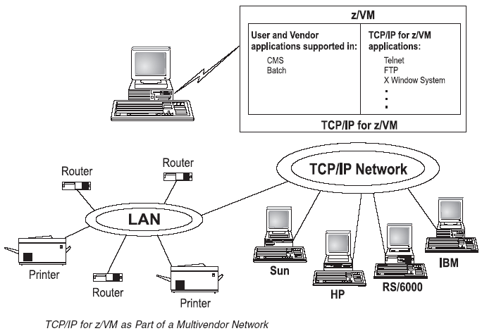
TCP/IP on z/VM

Slide 27
The TCP/IP Protocol Suite on z/VM

Slide 28
z/VM's TCP/IP Stack
Runs by default on the TCPIP userid
Provides TCP/IP services to client and server virtual machines (Transport, Network & Data Link Layers)
Also runs a Telnet server for establishing VM sessions (Application Layer)

Slide 29
Other Virtual Machines in the z/VM TCP/IP Protocol Suite
SMTP, FTPSERVE, REXECD, IMAP, etc...
Provide services to client applications
Appear as servers to client applications
However, they are considered clients of the TCPIP virtual machine

Slide 30
Configuring the z/VM TCP/IP Server

Slide 31
The TCPMAINT Userid
Used to perform administrative tasks for the TCP/IP stack and servers
Three main minidisks: 198, 591 & 592
  198 (D) disk: Server configuration files and local modules
  591 (E) disk: Server modules and sample config files
  592 (F) disk: Client modules and config files (TCPIP DATA)
These minidisks are accessed by the TCP/IP stack and servers.

Slide 32
Main Configuration Files
DTCPARMS (198)
  sample: none
TCPIP DATA (592)
  sample: TCPIP SDATA (592)
ETC HOSTS (592)
  sample: ETCHOSTS SAMPLE (592)
PROFILE TCPIP (198)
  sample: PROFILE STCPIP (591)

Slide 33
The DTCPARMS File
Defines a server and various startup parameters
Formatted as a CMS Names file (:<tag>.<value> pairs)‏
Search Order
  <userid> DTCPARMS
  <nodeid> DTCPARMS
  SYSTEM DTCPARMS
  IBM DTCPARMS
All but IBM DTCPARMS should reside on the TCP/IP server's 198 disk

Slide 34
DTCPARMS Tags
Required Tags
  :NICK.
    The user ID of the server being configured
  :TYPE.
    For IBM servers the type is “server”
  :CLASS.
    Defines what sort of server is being configured (FTP, TCP/IP Stack, MPRoute)‏
Other Tags
  :ATTACH.
    Attach a device to your TCP/IP Server
  :VNIC.
    Define and couple a virtual network card to a guest LAN or VSWITCH
  :OWNER.
    Define the owner of the TCP/IP Server (Default: TCPMAINT)‏
  :EXIT.
    Run a user defined exit

Slide 35
Sample SYSTEM DTCPARMS
:nick.TCPIP :type.SERVER :class.STACK
:attach.900-902

Slide 36
TCPIP DATA File
Defines system parameters used by both clients and servers
  The userid of the TCP/IP stack virtual machine
  Resolver Information
    host name
    domain name
    resolver preferences
    resolver tracing
    DNS servers to use
  The userid of an SMTP email server
Should reside on the TCP/IP Server's 592 disk (client code)‏

Slide 37
Sample TCPIP DATA
TCPIPUSERID TCPIP2
NSINTERADDR 10.6.3.252
NSINTERADDR 10.6.3.253
HOSTNAME vmhost1
DOMAINORIGIN testnet.bigblue.com
DOMAINLOOKUP DNS
SMTPUSERID SMTP2

Slide 38
ETC HOSTS
Contains local host names and their associated IP addresses
Enables name resolution and reverse name resolution without using a domain name server
Similar to the /etc/hosts file on a Linux system

Slide 39
Sample ETC HOSTS
127.0.0.1 localhost loopback
149.125.15.79 merwynvm.bu
149.125.15.240 hust.bu

Slide 40
PROFILE TCPIP
Primary TCP/IP server configuration file
Search order:
  <userid> TCPIP
  <nodeid> TCPIP
  PROFILE TCPIP
Only one is used
Should reside on the TCP/IP server's 198 disk

Slide 41
Configuration Statements - AUTOLOG, PORT
AUTOLOG
  Defines which servers to start when the stack comes up
  Stack will restart the server if it is logged off
PORT
  Gives permission for a server to listen on a port
  Low ports (0-1023) are restricted by default
  Listed ports are monitored unless NOAUTOLOG is specified
  Used to start the Telnet server (assign a port to INTCLIEN)‏
Examples:
  AUTOLOG
  ftpserve 0
  ENDAUTOLOG
  PORT
  20 tcp ftpserve noautolog
  21 tcp ftpserve

Slide 42
Configuration Statements - HOME
Configures IP addresses and subnet masks for each link
  If a subnet mask is specified, a subnet route will be generated for that interface (i.e. You won't need a GATEWAY entry for it)‏
Example:
  HOME
  10.6.3.159 255.255.255.0 eth0
  192.8.12.12/27 eth1
  192.4.0.1 255.255.255.252 vctc0

Slide 43
Configuration Statements - Device and Link
Configure network interfaces to the stack
Examples:
  Real QDIO Ethernet Device
    DEVICE qdio0 OSD 1e00 PRIROUTER
    LINK eth0 QDIOETHERNET qdio0 MTU 1500
  Virtual QDIO Ethernet Device
    DEVICE qdio1 OSD e100 NONROUTER
    LINK veth0 QDIOETHERNET qdio1 MTU 32768
  LCS Ethernet Device
    DEVICE lcs0 LCS 1f08
    LINK eth1 ETHERNET 0 lcs0 MTU 1500
  Virtual Channel to Channel Device
    DEVICE ctc0 CTC 800
    LINK vctc0 CTC 1 ctc0 MTU 32760

Slide 44
Configuration Statements - GATEWAY and START
GATEWAY – Defines static routes
START – Starts devices
Examples:
  GATEWAY
  10.6.3.0 255.255.255.0 = eth0 0
  192.8.12.19 255.255.255.240 = veth0 0
  192.8.12.12/27 = eth1 0
  192.4.0.2 HOST = ctc0 0
  DEFAULTNET 10.6.3.1 eth0 0
  DEFAULTNET 192.8.12.1 eth1 0
  START qdio0
  START qdio1
  START lcs0
  START ctc0

Slide 45
Sample PROFILE TCPIP
AUTOLOG
smtp
ENDAUTOLOG
PORT
25 tcp SMTP
DEVICE dev1 OSD 900
LINK lnk1 QDIOETHERNET dev1
HOME
149.125.15.12 255.255.255.0 lnk1
GATEWAY
149.125.15.0 255.255.255.0 = lnk1 0
DEFAULTNET 149.125.15.1 lnk1 0
START dev1

Slide 46
Server Specific Configuration Files
SRVRFTP CONFIG (198)
  sample: SRVRFTP SCONFIG (591)
SMTP CONFIG (198)
  sample: SMTP SCONFIG (591)
IMAP CONFIG (198)
  sample: IMAP SCONFIG (591)
VMNFS CONFIG (198)
  sample: VMNFS SCONFIG (591)

Slide 47
Verifying the Configuration
Use NETSTAT commands once the stack is up and running
  NETSTAT GATE
    Display the stack's routing table
  NETSTAT HOME
    Display the current home IP addresses assigned to the TCP/IP stack
  NETSTAT DEVLINKS
    Display the status of all interfaces (DEVICE and LINK pairs)
  NETSTAT CONFIG ALL
    Display information on ASSORTEDPARMS, INTERNALCLIENTPARMS, OBEY, PERMIT, PORT, RESTRICT, TRACE and TRANSLATE statements.

Slide 48
Networking on z/VM
- TCP/IP on z/VM
- Networking Hardware on z/VM
- Virtual Networking on z/VM

Slide 49
Networking Hardware on z/VM
Parallel Channels (Bus & Tag)
Channel-to-channel (CTC)
  ESCON
  FICON
QDIO - Open System Adapter (OSA)
HiperSockets

Slide 50
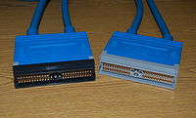
Parallel Channels (Bus & Tag Cables)
One of the oldest interfaces to the IBM mainframe (introduced in 1960) and was used to connect periheral devices to the mainframe
Used two parallel channels called bus (carried one byte of data in each direction) and tag (carried control info to indicate the meaning of the data)
Used copper wire and could only run 400 feet
Maximum data rate of a parallel channel was 4.5 MBps

Slide 51
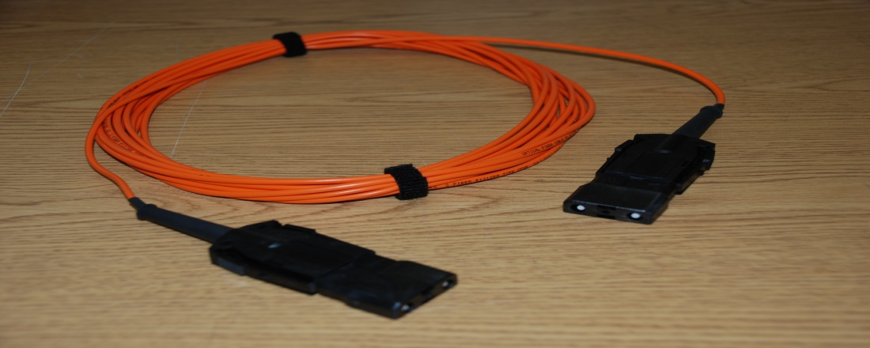
ESCON
(Enterprise System Connectivity)
The high-speed fiber optic architecture first available on ES/9000 and many other peripherals in the early 1990's
No longer parallel, but half-duplex serial bit transmission (data goes in both directions, but one direction at a time)
Originally used LEDs and worked at 10MBps over 3 km stretches
A laser version announced in 1991 is capable of working at greater distances
Was replaced by FICON in 1998, though still available

Slide 52
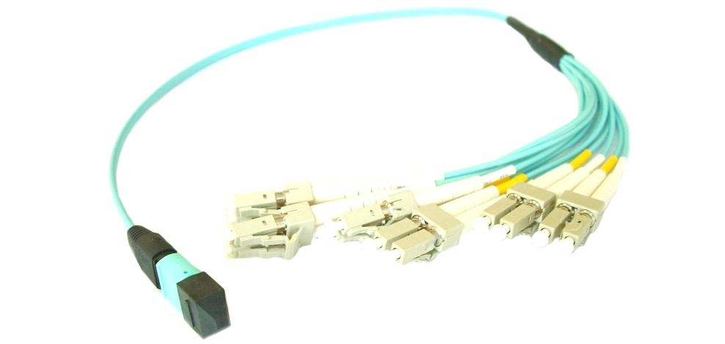
FICON (Fibre Connections)
Uses fiber optic cable like ESCON, but allows concurrent sharing of the channel for full-duplex data transmission (both directions at same time)
Maximum data rate of 2 GBps
Up to 10 km of unrepeated distance

Slide 53
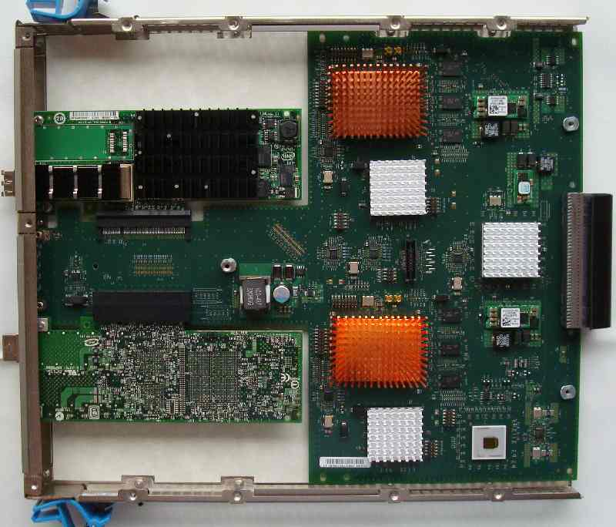
Open Systems Adapter (OSA)
The strategic communications device for IBM System Z mainframes
Actually a network controller that plugs right into the mainframe cage and integrates the control unit and device into the same hardware
Supports a new data transfer architecture called Queued Direct I/O (QDIO) which dramatically improves data transfer speed and efficiency by allowing direct access to mainframe storage
The OSA channel is shared among all LPARs in the mainframe (no longer point-to-point, but port sharing)
Supports data transfer rate of 10 Gbps for unrepeated distance of 10km

Slide 54
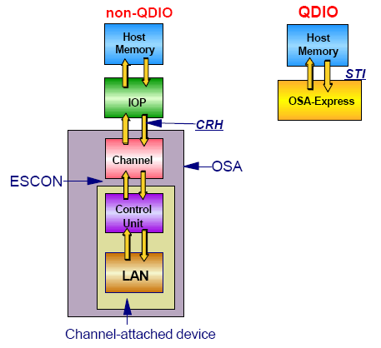
Queued Direct I/O (QDIO)

Slide 55
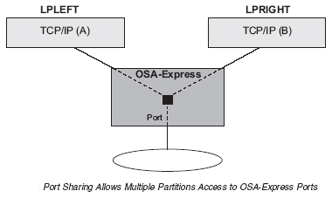
OSA-Express Characteristics

Slide 56
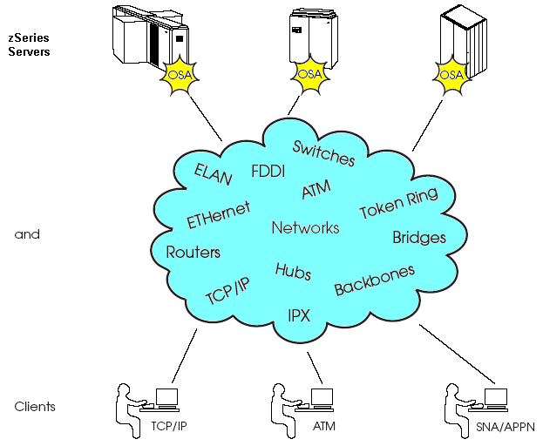
Open System Adapters

Slide 57
What Are HiperSockets and What Benefits Do They Provide?
They provide very fast TCP/IP communications between servers running in different LPARs on a zSeries CEC.
HiperSockets uses internal Queued Input/Output (iQDIO) at memory speeds to pass traffic between the virtual servers (bypassing network overhead).
Important aspects of HiperSockets include:
  They can be used to communicate among consolidated servers in a single processor
  They can be customized to accommodate varying traffic sizes
  Since there is no server-to-service traffic outside the zSeries CEC, they provide a much higher level of network availability, security, simplicity, performance, and cost effectiveness

Slide 58
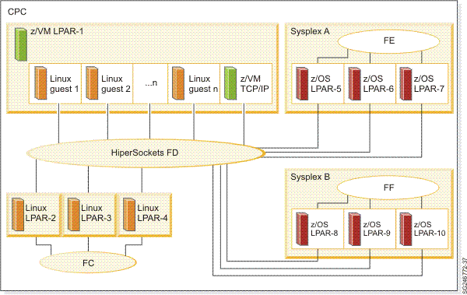
An Example of Hipersockets Usage
Connected with HiperSockets CHPID FD are all the servers in the mainframe CPC:
- The multiple Linux servers running under z/VM in LPAR-1
- The z/VM TCP/IP stack running in LPAR-1
- The three Linux servers in LPARs 2 to 4
- All z/OS servers in sysplex A (LPARs 5 to 7) for non-sysplex traffic
- All z/OS servers in sysplex B (LPARs 8 to 10) for non-sysplex traffic

Slide 59
Networking on z/VM
- TCP/IP on z/VM
- Networking Hardware on z/VM
- Virtual Networking on z/VM
-- Guest LANs
-- Virtual Network Interface Card
-- VSWITCH

Slide 60
Guest LANs

Slide 61
z/VM Guest LAN
Linux
VM TCP/IP
VSE
z/OS
Virtual QDIO adapter
Guest LAN
CP
Same LAN sement and subnet

Slide 62
z/VM Guest LAN
Guest
Guest
Guest
A simulated LAN segment
  QDIO:
    IPv4 and IPv6
  HiperSockets:
    IPv4 and IPv6
  No built-in connection to outside network
As many as you want
Created in SYSTEM CONFIG or by CP DEFINE LAN command
Guest
Guest
Guest
Guest

Slide 63
Primary Guest LAN Attributes
Name & Owner
Type
Access list
Persistent or Transient
many other attributes not discussed here
Note: Some attributes can be changed after the LAN is defined

Slide 64
LAN Name and Owner
The LAN name is a simple 1-8 character token
The LAN owner is a VM user ID or “SYSTEM”
(name, owner) is unique within the system
A Class G LAN owner can
  modify the LAN access list
  delete the LAN
A Class B user can create, modify, or detach any LAN

Slide 65
HiperSockets or QDIO
TYPE HIPERsockets | QDIO
HiperSockets
  Synchronous
  Low latency
  Slightly smaller path length in CP (less CPU time)
QDIO
  OSA-Express in QDIO mode
  Asynchronous
  Higher latency than HiperSockets
  Higher CPU cost

Slide 66
Access list
Unrestricted
  Any user can connect (couple) to this LAN
  Hint: CP QUERY LAN can show you who is connected
Restricted
  Only users in the access list can connect (couple) to this LAN
  LAN owner uses CP SET LAN to GRANT or REVOKE access
  CP QUERY LAN can show you the current access list
  CP QUERY LAN can show you who is connected

Slide 67
Persistent vs. Transient LAN
Persistent / Transient is inferred from other attributes
  Any LAN owned by user “SYSTEM” is persistent
  Any LAN created by SYSTEM CONFIG is persistent
  All other LANs are transient
A persistent LAN must be explicitly deleted by CP DETACH LAN
A transient LAN is automatically deleted when the last user uncouples from the LAN

Slide 68
Create a Guest LAN
DEFINE LAN in SYSTEM CONFIG
CP DEFINE LAN to create dynamically
DEFINE LAN name [OWNERid ownerid]
[TYPE HIPERsockets|QDIO]
[UNRESTricted|RESTricted]
Example:
DEFINE LAN BUTEST OWNER SYSTEM TYPE QDIO
DEFINE LAN NET9 OWNER SYSTEM RESTRICTED TYPE QDIO

Slide 69
Virtual Network
Interface Card

Slide 70
Virtual Network Interface Card (NIC)
Virtual Machine
A simulated network adapter
  OSA-Express QDIO
  HiperSockets
  Must match LAN type
3 devices per NIC
Provides access to Guest LAN or Virtual Switch
Created by directory or CP DEFINE NIC command
Guest LAN or virtual switch

Slide 71
Virtual NIC - User Directory
May be automated with USER DIRECT file:
NICDEF vdev [TYPE HIPERS | QDIO]
[DEVices devs]
[LAN owner name]
Example:
NICDEF 1100 TYPE QDIO LAN SYSTEM BUTEST

Slide 72
Virtual NIC - CP Command
May be interactive with CP DEFINE NIC and COUPLE commands:
CP DEFINE NIC vdev
[[TYPE] HIPERsockets|QDIO]
CP COUPLE vdev [TO] owner name
Example:
CP DEFINE NIC 1200 TYPE QDIO
CP COUPLE 1200 TO SYSTEM BUTEST

Slide 73
Virtual Switch

Slide 74
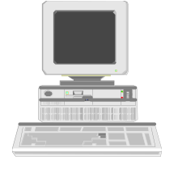
z/VM Virtual Switch
Linux
VM TCP/IP
VSE
z/OS
Virtual QDIO adapter
Virtual Switch Guest LAN
CP
OSA-Express
Same LAN segment and subnet
Ethernet LAN

Slide 75
z/VM Virtual Switch
guest
guest
guest
A special-purpose Guest LAN
  Built-in bridge to outside network
Each Virtual Switch has up to 8 separate OSA-Express connections associated with it
Created in SYSTEM CONFIG or by
CP DEFINE VSWITCH command
CP
Router
AIX

Slide 76
Virtual Switch Attributes
Name
Associated OSAs
One or more controlling virtual machines (minimal VM TCP/IP stack servers)
  Controller not involved in data transfer
  Do not ATTACH or DEDICATE
  Use pre-configured DTCVSW1 and DTCVSW2
Similar to Guest LAN
  Owner SYSTEM
  Type QDIO
  Persistent
  Restricted

Slide 77
Create a Virtual Switch
SYSTEM CONFIG or CP command:
DEFINE VSWITCH name
[RDEV NONE | dev [dev [dev]] ]
[CONNECT | DISCONNECT]
[CONTROLLER * | userid]
Example:
DEFINE VSWITCH SWITCH1 RDEV 1E00 1F04

Slide 78
Change the Virtual Switch access list
Specify after DEFINE VSWITCH statement in SYSTEM CONFIG to add users to access list
MODIFY VSWITCH name GRANT userid
SET VSWITCH name GRANT userid
SET VSWITCH name REVOKE userid
Examples:
MODIFY VSWITCH SWITCH12 GRANT LNX01
CP SET VSWITCH SWITCH12 GRANT LNX02
CP SET VSWITCH SWITCH12 REVOKE LNX03

Slide 79
An Example

Slide 80
Simple Virtual Switch LAN Segment (VSWITCH)
Create a simulated Layer 2 or Layer 3 switch device
Virtual machine access control and VLAN authorization
Linux
Linux
Linux
Linux
Linux
Linux
NIC
NIC
NIC
NIC
NIC
NIC
Create ports and connect NIC to virtual switch (LAN Segment)
Provides full MAC address management (generation and assignment)
Port 65
Port 66
Port 67
Port 68
Port 69
Port 70
Virtual Switch
Forwards traffic between Guest Ports by either IP or MAC address
1-n VSWITCHs per z/VM image
z/VM
System z LPAR
Example
Create VSWITCH from PRIVCLASS B User ID
  DEF VSWITCH VSWITCH1 ETHERNET
  SET VSWITCH VSWITCH1 GRANT {user ID}
From Linux Virtual Machines
  DEF NIC 100 TYPE QDIO
  COUPLE 100 SYSTEM VSWITCH1
Physical Switch

Slide 81
Cascading a Virtual to a Physical Switch
Linux
Linux
Linux
Linux
Linux
Linux
VM TCPIP
Controller
Start VM TCPIP Controllers
XAUTOLOG DTCVSW1
XAUTOLOG DTCVSW2
VM TCPIP
Controller
NIC
NIC
NIC
NIC
NIC
NIC
Port 65
Port 66
Port 67
Port 68
Port 69
Port 70
Virtual Switch
Port 1
z/VM
System z LPAR
QDIO Connection (3 Devices)
Read Control Device
Write Control Device
Data Device
Connect the Real Switch
SET VSWITCH VSWITCH1 RDEV 100
OSA
Port 1
Physical Switch

Slide 82
Adding a Failover Device
Linux
Linux
Linux
Linux
Linux
Linux
VM TCPIP
Controller
Issue the SET VSWITCH command and include the new RDEV
VM TCPIP
Controller
NIC
NIC
NIC
NIC
NIC
NIC
Port 65
Port 66
Port 67
Port 68
Port 69
Port 70
Virtual Switch
Port 1
Port 2
z/VM
System z LPAR
OSA
Example
SET VSWITCH VSWITCH1 RDEV 100 500
SET VSWITCH VSWITCH1 CONNECT
OSA
Port 1
Backup Physical Switch
Port 1
Physical Switch

Slide 83
Port Failover
Linux
Linux
Linux
Linux
Linux
Linux
VM TCPIP
Controller
Port Error
VM TCPIP
Controller
NIC
NIC
NIC
NIC
NIC
NIC
Port 65
Port 66
Port 67
Port 68
Port 69
Port 70
Virtual Switch
Port 1
Port 2
z/VM
QDIO connection terminated on the primary OSA device and is established and activated on the BACKUP device
Only one QDIO Connection is active at any point in time
System z LPAR
OSA
OSA
Port 1
Backup Physical Switch
Port 1
Physical Switch

Slide 84
Guest LAN vs. Virtual Switch
Guest
Guest
Guest
Guest
Guest LAN
Guest
Virtual Switch
Ethernet LAN
Virtual router is required
Different subnet
External router awareness
Guest-managed failover
No virtual router
Same subnet
Transparent bridge
CP-managed failover

Slide 85
References
Publications:
  z/VM TCP/IP Planning and Customization
  z/VM Connectivity
  z/VM CP Planning and Administration
  z/VM CP Command and Utility Reference

